Slide 1
(a)
(b)
(c)
(d)

Slide 2
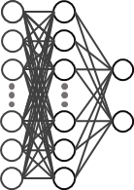
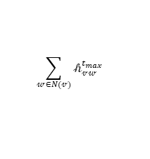




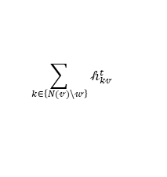


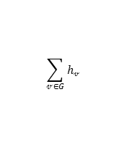

ReLU
$$\left[\begin{matrix}𝓍𝓋 & … & ℯ𝓋𝓌\end{matrix}\right]×\text{𝒲}\text{𝒾}$$
$$𝒽_{𝓋𝓌}^{0}$$
$$\sum_{k∈\left\{N(𝓋)\backslash 𝓌\right\}}{𝒽_{k𝓋}^{t}}$$
ReLU
$$𝒽_{𝓋𝓌}^{0}\text{+}{[m}_{𝓋𝓌}^{t+1}]×\text{𝒲}\text{𝒽}$$
$$𝒽_{𝓋𝓌}^{t+1}$$
$$\sum_{𝓌∈N(𝓋)}{𝒽_{𝓋𝓌}^{t_{max}}}$$
$$\sum_{𝓋∈G}{h𝓋 }$$
ReLU
$$\left[\begin{matrix}𝓍𝓋 & … & m𝓋\end{matrix}\right]×\text{𝒲}\text{𝒶}$$
$$h𝓋$$
.
$$h$$
$$properties$$

Slide 3


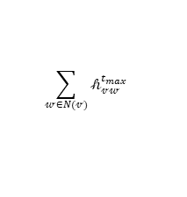

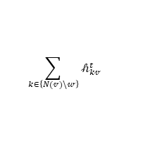
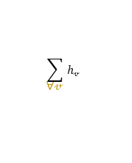




ReLU
$$𝒽_{𝓋𝓌}^{0}$$
$$\left[atom and bond features\right]×\text{𝒲}\text{𝒾}$$
∀𝓋
$$\sum_{k∈\left\{N(𝓋)\backslash 𝓌\right\}}{𝒽_{k𝓋}^{t}}$$
ReLU
$$𝒽_{𝓋𝓌}^{t+1}$$
$$𝒽_{𝓋𝓌}^{0}\text{+[}messages]×\text{𝒲}\text{𝒽}$$
∀𝓋
$$\sum_{𝓌∈N(𝓋)}{𝒽_{𝓋𝓌}^{t_{max}}}$$
$$\sum_{\text{∀}\text{𝓋} }{h𝓋 }$$
ReLU
$$\left[\begin{aligned}messages and \\ atom features\end{aligned}\right]$$
$$×\text{𝒲}\text{𝒶}$$
$$h𝓋$$
$$h$$
∀𝓋
$$properties$$

